Slide 1

HR ATTRITION ANALYSIS
Insights and Recommendations to support business decision-making
Prepared by: Mohamed Abdo
Date: 24/9/2026
Case Study: HR Employee Attrition Analysis

Slide 2
Business Context and Objective
Employee attrition currently stands at 16.1% with 237 out of 1,470 employees having left the company.
This analysis identifies the key drivers behind attrition, detects meaningful outliers and segments, and translates the findings into actionable retention recommendations.
16.1%
Attrition Rate
1,470
16.1%
Total Employees
Attrition Rate
237 employees left
out of 1,470
$6,503
5.13 Years
AVG Monthly Income
AVG Tenure Left

Slide 3
Methodology
1
Data Modeling
Built a star schema in Power BI, separating employee facts from Department, Job, Education, and Profile dimensions.
DAX Measures
2
Developed DAX measures to calculate attrition rates , totals and satisfaction indices.
Outlier Detection
3
Applied the Interquartile Range (IQR) method on key numeric fields to identify statistically meaningful outliers.

Slide 4

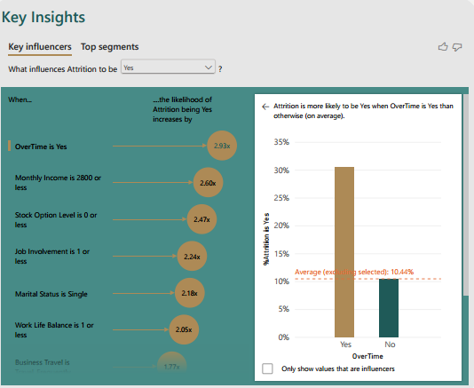
Key Drivers of Attrition
1
Overtime
Employees working overtime leave at 30.5% nearly 3x the rate of those who don't (10.4%).
2
Job Involvement
Attrition drops steadily from 33.7% (Low) to 9.0% (Very High).
3
Stock Option Level
No stock options → 24.4% attrition, vs. under 10% for those with options.
4
Marital Status
Single employees leave at 25.5% more than married employees (12.5%).
5
Work-Life Balance
Poor work-life balance correlates with a 31.2% attrition rate.

Slide 5
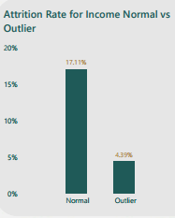
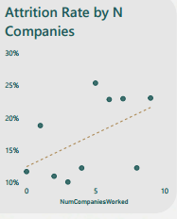
Outlier and Segment Analysis
Monthly Income Outliers
Job-Hopping Outliers
114 employees (7.8% of workforce) earn significantly above Normal (<$16,581/month).
Employees with an unusually high number of previous companies worked show a clear attrition pattern.
4.4%
vs 17.1% (Normal)
Attrition Rate
23.1%
vs 15.9% (Normal)
Attrition Rate

Slide 6
Risk Score: A Composite Retention Indicator
Combines: Overtime, Low Job Involvement, No Stock Options, Single Marital Status,
Poor Work-Life Balance, and Low Job Satisfaction (0–6 scale)
High-Priority Segment
Score ≥ 4
Employees scoring 4 or higher show attrition rates of 45.9% and 66.7% requiring immediate retention intervention.
138 employees
(9.4% of workforce)

Slide 7
Recommendations
1
Review overtime policies
The single strongest attrition driver; consider workload redistribution .
2
Expand stock option eligibility
Particularly for currently excluded employees, given the strong link to retention.
3
Launch work programs
Target employees with low Job Involvement scores.
4
Review compensation structures
For mid-tier employees, informed by the income-retention relationship in outlier analysis.
5
Prioritize high Risk Score employees (4+)
For proactive retention conversations and career development plans.
7

